Slide 1

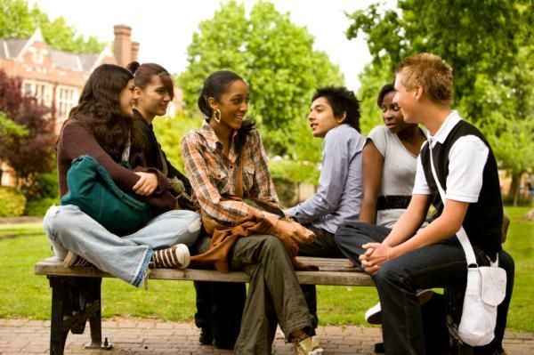
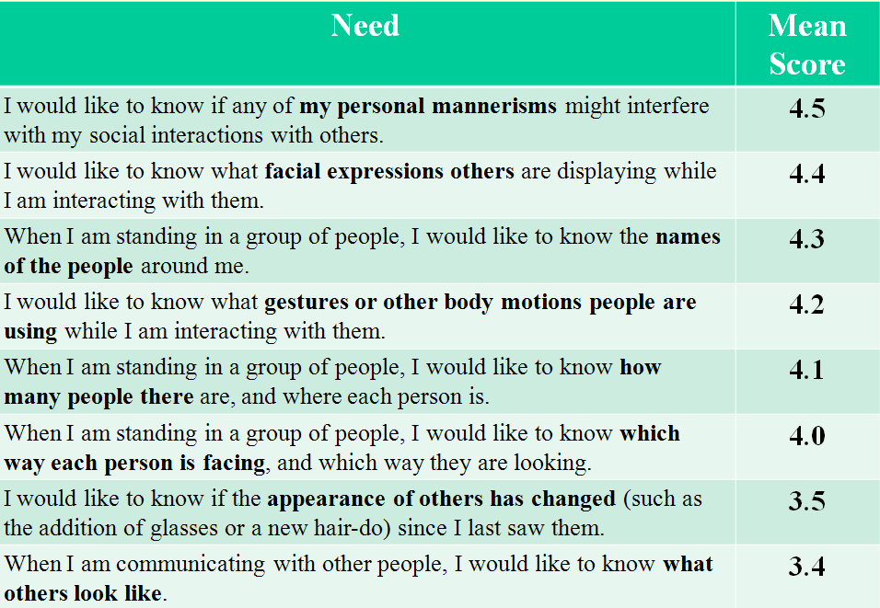
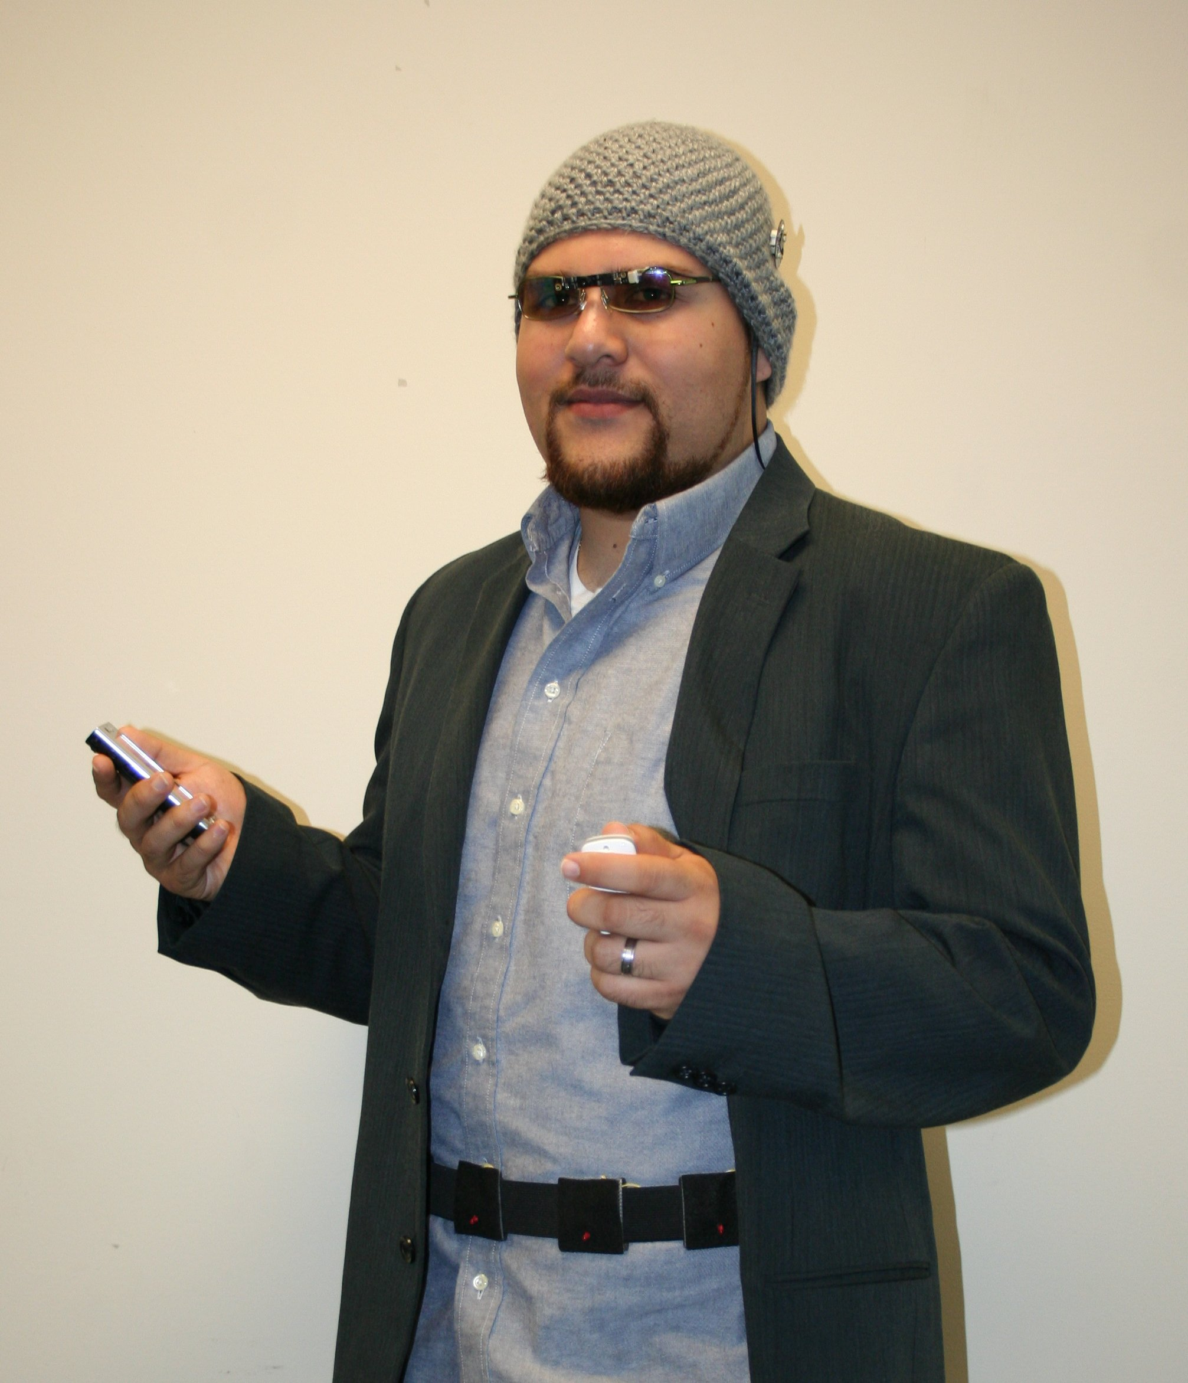
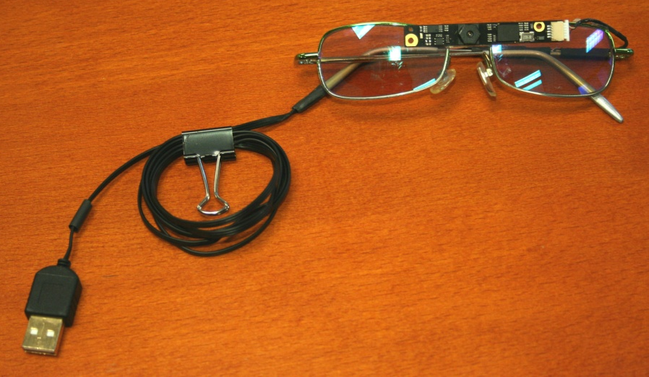
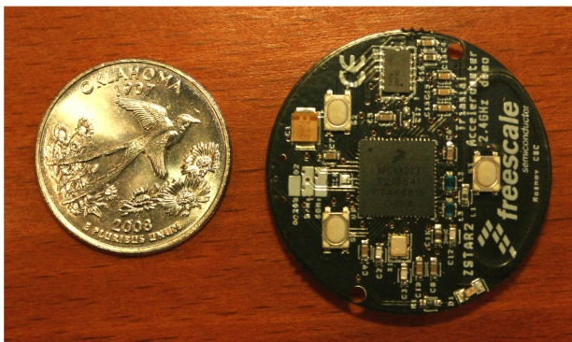

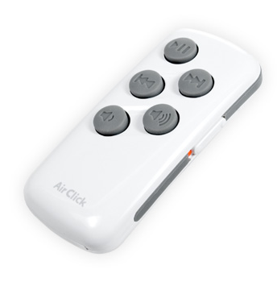
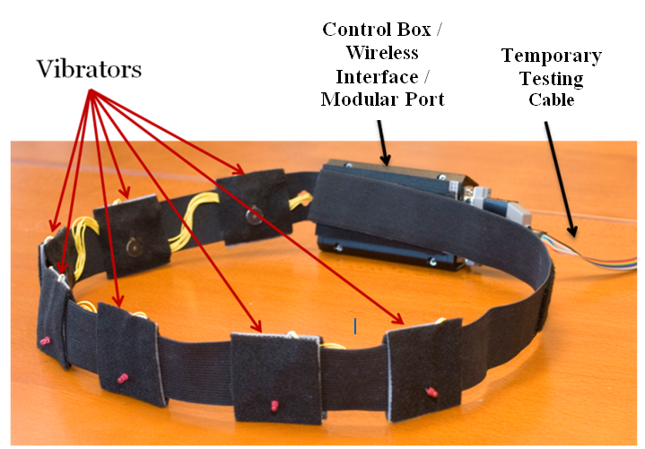
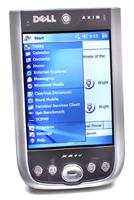
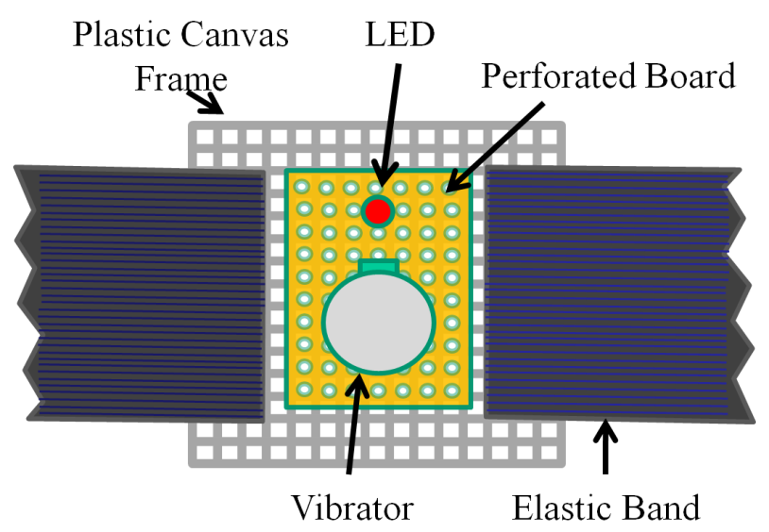
VibroGlove
An Assistive Technology Aid for Conveying Facial Expressions
Sreekar Krishna† , Shantanu Bala, Stephen McGuire, Troy McDaniel &Sethuraman Panchanathan
CUbiC Center for Cognitive Ubiquitous Computing
http://cubic.asu.edu
Social Interactions
Social interactions are an essence of healthy living.
People with physical and cognitive disabilities are at a loss when it comes to social interactions.
Assistive and rehabilitative tools developed towards enhancing social interactions could prove beneficial towards general understanding of Interpersonal communications and Socio-Computing.
Results from online web survey to assess importance of social interactions from people who are blind or visually impaired
Embodied Social Interaction Assistant
Sensing Element
Accelerometer
1.3 Megapixel Digital Camera
User Interface
Haptic Belt
Processing Element
Individual Vibrator
† Contact Author: Sreekar Krishna, Graduate Research Assistant, Center for Cognitive Ubiquitous Computing (CUbiC: http://cubic.asu.edu/), Arizona State University, Tempe, AZ. Ph: (480) 727-3612 Fax: (480) 965-1885 Email: Sreekar.Krishna@asu.edu

